Slide 1


Chroma Key Replacement
Presented to: Eng.Mohamed Abdullah
Dr.Dina Tantawy
CMP 2024

Slide 2
Table of Contents
01
Introduction
02
How does it work
03
Performance Analysis

Slide 3
01
Introduction

Slide 4


Introduction
Chroma Key Replacement: is a visual effects technique.
Used to composite two images. This technique is widely used in video production, filmmaking, and image processing.
Replace a solid background color (usually green or blue) with a different background, enabling the creation of immersive visual effects and scenes.

Slide 5
02
How does it work

Slide 6
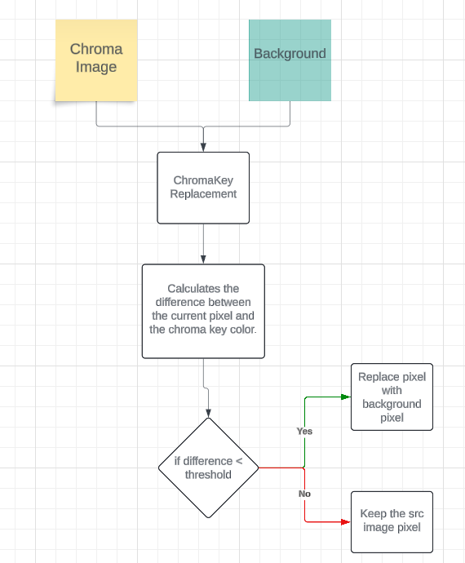
Flow

Slide 7
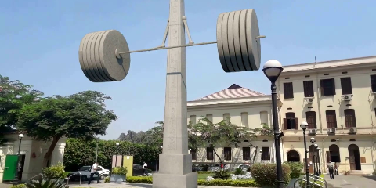


Tests
480x240
+
=

Slide 8

Tests
640x480
+
=

Slide 9



Tests
700x900
+
=

Slide 10



Tests
1920x1080
+
=

Slide 11
03
Performance Analysis

Slide 12
Performance Analysis
Image Resolution | GPU Time | CPU Time | Speedup= CPU/GPU
480x240 | 0.00031553 seconds | 0.00137312 seconds | 4.35
640x480 | 0.00022975 seconds | 0.00205611 seconds | 8.94
700x900 | 0.00028273 seconds | 0.00420714 seconds | 14.88
1920x1080 | 0.00044120 seconds | 0.0140391 seconds | 31.8

Slide 13
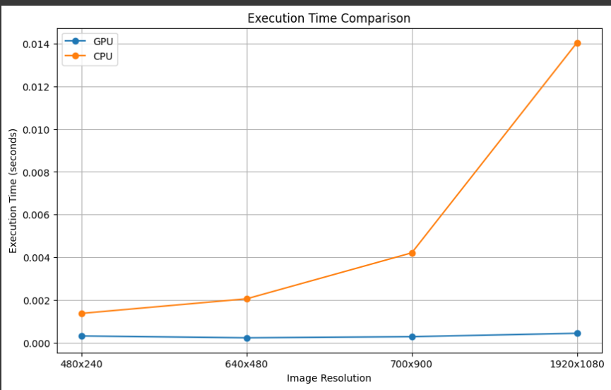
Performance Analysis
GPU Code vs CPU Code

Slide 14
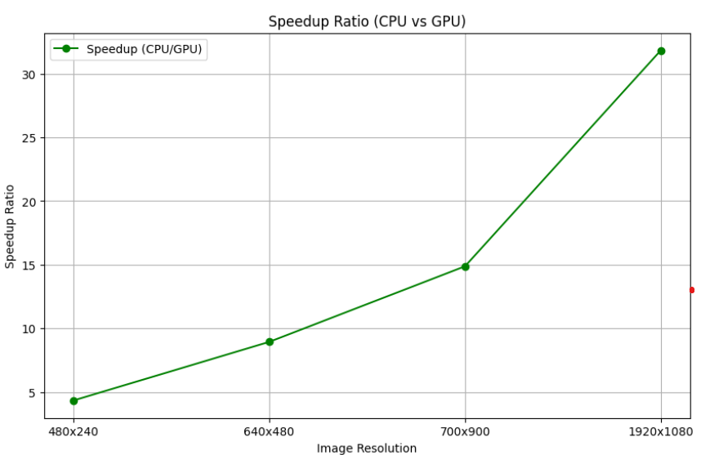
Performance Analysis
GPU Code vs CPU Code

Slide 15
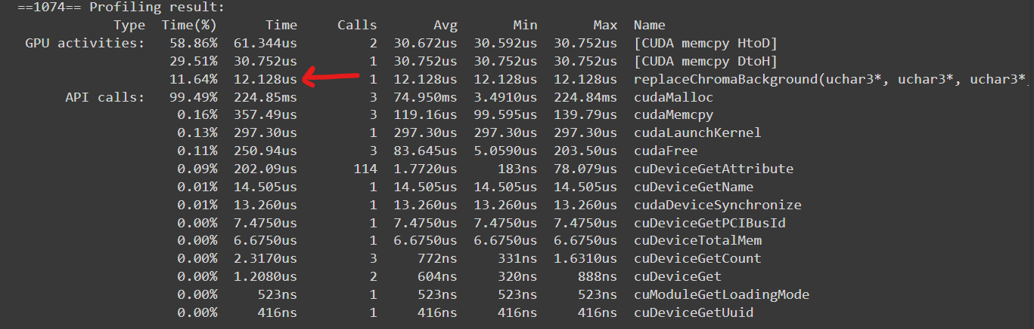
GPU Profiling
480x240

Slide 16
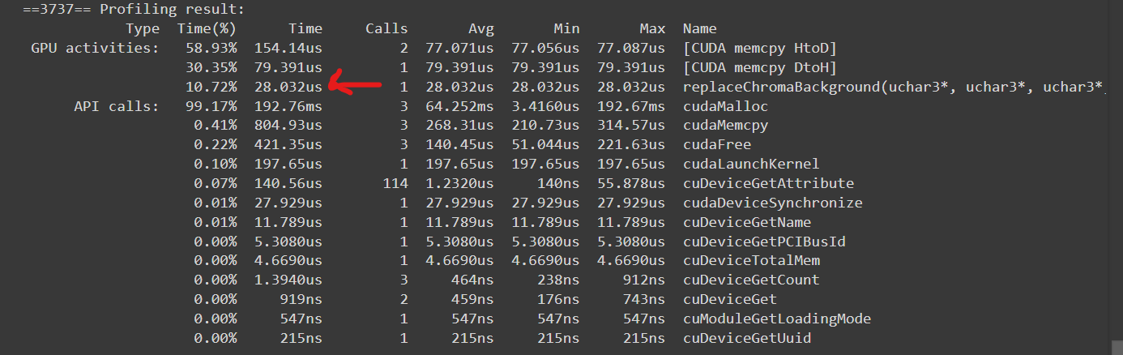
GPU Profiling
640x480

Slide 17
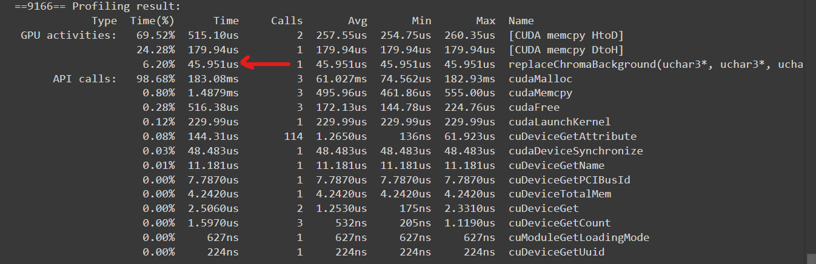
GPU Profiling
700x900

Slide 18
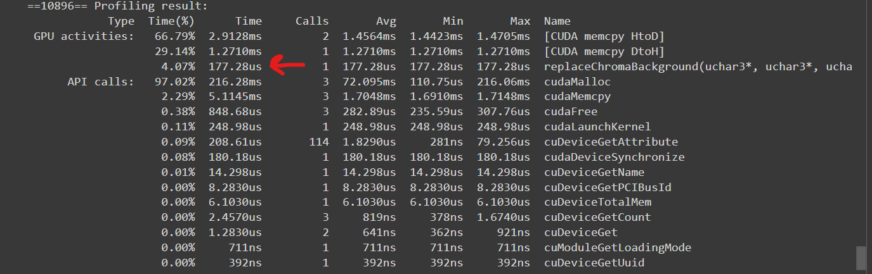
GPU Profiling
1920x1080

Slide 19
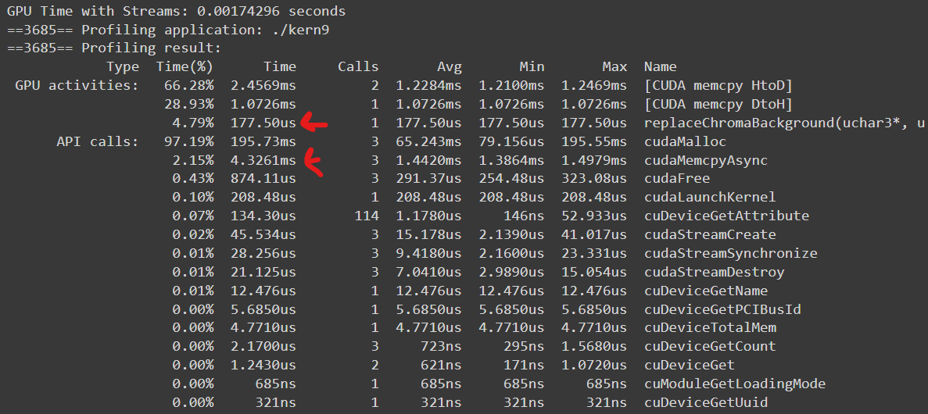
GPU Profiling
1920x1080 (with streams)

Slide 20
Performance Analysis
Theoretical Complexity
GPU: O(1) as each thread operates over one pixel
CPU: O(n) as it loops over rows and columns so it’s the number of pixels in the image

Slide 21
Performance Analysis
Theoretical Speedup = CPU/GPU = O(n)/O(1)
For 640x480 speedup=307200
For 700x900 speedup= 630000
For 1920x1080 speedup= 2073600

Slide 22
Performance Analysis
Compare between Theoretical and actual speedup
For 640x480 speedup= 34362
For 700x900 speedup= 42338
For 1920x1080 speedup= 65207

Slide 23
Performance Analysis
Why the speedup is less than the theoretical one?
Memory Transfer Overhead: Data transfer between CPU and GPU adds latency (use streams).
Parallel Efficiency: Not all code sections are efficiently parallelized.
Resource Contention: Multiple threads may contend for resources.

Slide 24
Performance Analysis
How to achieve better speed up?
Coalesced Memory Access: meaning that threads in a warp access contiguous memory locations
Use Shared Memory
Fine-Tune Kernel Configuration: Adjust the block and grid sizes for better performance based on the specific GPU architecture.

Slide 25
Benchmarking
Our GPU Code vs Pytorch with CUDA
Image Resolution | GPU | Pytorch | Speedup= GPU/Pytorch
640x480 | 0.00022975 seconds | 0.000225 seconds | 1.02
700x900 | 0.00028273 seconds | 0.000239 seconds | 1.18
1920x1080 | 0.00044120 seconds | 0.000316 seconds | 1.39

Slide 26
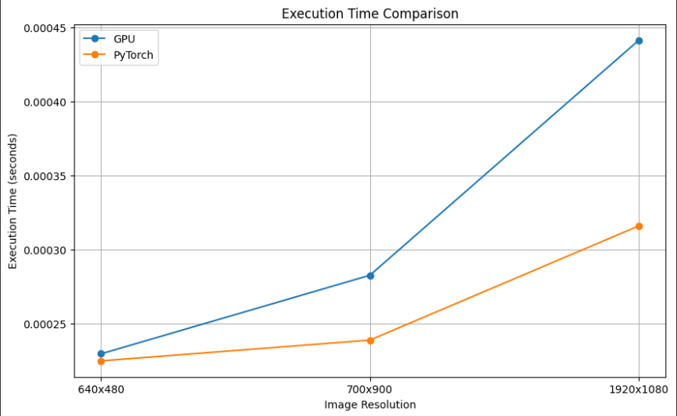
Benchmarking
Our GPU Code vs Pytorch with CUDA

Slide 27
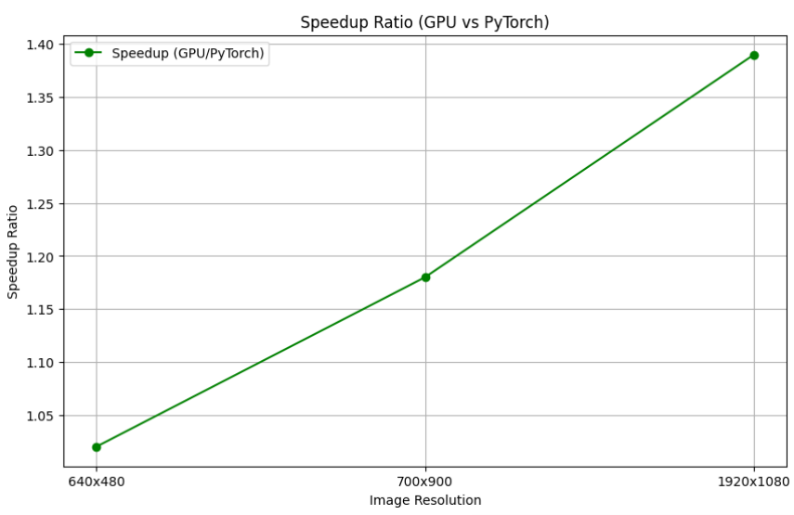
Benchmarking
Our GPU Code vs Pytorch with CUDA

Slide 28
Thank You

